Slide 1
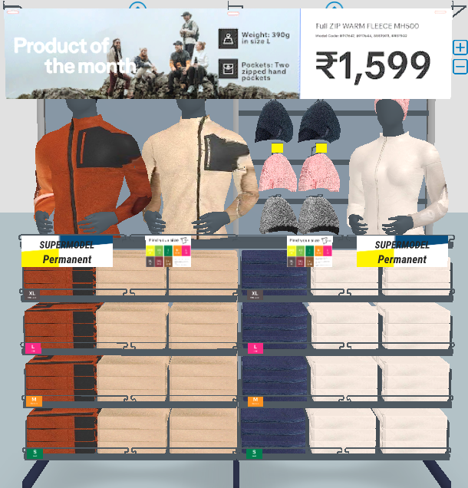
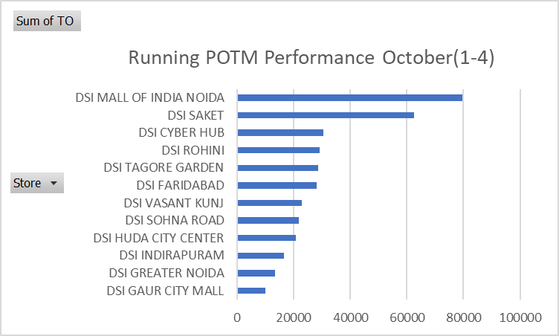
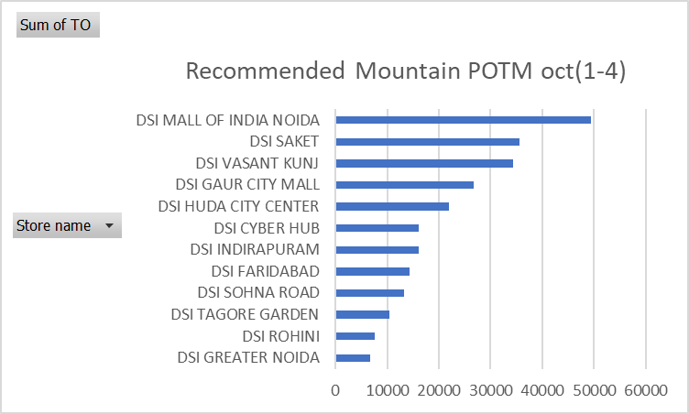
POTM performance Comparison Oct(1-4)

Slide 2
POTM performance Comparison Oct(1-4)
MODELS (Running) | TO
JOGFLOW 190.1 GRIP M BLUE | 36,289.0
TSHIRT RUN DRY+ M BEIGE HEATHER | 4,730.2
SHORT RUN DRY+ M BLACK CN | 1,598.0
TRAIL RUNNING BAG 500 8 L GREY | 9,998.0
KIPRUN SHORT LIGHT D16A | 3,897.0
*IN ENERGY GEL *1 LIME&LEMON | 1,386.0
*IN ENERGY GEL *1 PASSIONFRUIT | 1,188.0
*IN ENERGY GEL X1 ESPRESSO | 990.0
SOFT FLASK 150ML EXTRUD | 2,397.0
MODELS (MOUNTAIN) | TO
FLEECE MH 500 FULL ZIP POCKET TC MAN | 20,787.0
FLEECE MH500 ZIP BEIGE EMB W | 3,198.0
FLEECE MH 500 FULL ZIP POCKET BEIGE MAN | 6,396.0
FLEECE MH500 ZIP W | 3,198.0
HAT SIMPLE NAVY | 1,495.0
HAT SIMPLE LIGHT GREY | 598.0

